Slide 1
Capstone Project
NYC Taxi Trip Time Prediction By Krushna Chaure Data Science Trainee AlmaBetter,Bangalore

Slide 2
Topic for Discussion
1. Introduction
2. Problem Statement
3. Understand Dataset
4. Data Wrangling
5. EDA(Exploratory Data Analysis)
(a) Univariate
(b) Bivariate
(c) Multivariate
6. Hypothesis Testing
7. Feature Engineering & Data Pre-processing
8. ML Model Implementation - Multiple Linear Regression
9. ML Model Implementation – Decision Tree Regressor
10. ML Model Implementation - XGBoost Regressor
11. ML Model Implementation - Random Forest Regressor
12. Challenges Faced
13. Conclusion

Slide 3
Introduction
More than 7 billion people exist on earth. With necessities of food, water and shelter there also a key requirement of commutating from one place to other. Rapid advancement in technology in the last two decades leads to adaption of a more efficient way of transportation via internet and app-based transport system. New York city is one of such advanced city with extensive use of transportation via subways, buses and taxi services. New York has more then 10,000 plus taxi and nearly 50% of population doesn’t have a personal vehicle. Due to this facts most people used taxi has a there primary mode of transport and it accounts for more than 100 millions taxi trips per year.
Our primary motives are to analyse the dataset, perform feature engineering to comes up with suitable independent features and building a good model that will help us in predicting the trip duration of NYC taxi.
Here, for prediction the taxi trip duration we have applied a linear regression, Decision Tree Regressor and then we have applied Random Forest regressor and XGBoost To find out which will give better accuracy and with lesser amount of prediction time.

Slide 4
Problem Statement
Our task is to build a machine learning model that predicts the total ride duration of taxi trips in New York City. Our primary dataset is one released by the NYC Taxi and Limousine Commission, which includes pickup time, geo-coordinates, number of passengers, and several other variables.

Slide 5
Understand Dataset
Independent variable:-
id - Unique identifier for each trip.
vendor_id - Code indicating the provider associated with the trip record.
pickup_datetime - Date and Time when the meter was engaged.
dropoff_datetime - Date and Time when the meter was disengaged.
passenger_count - The number of passengers in the vehicle (driver entered value)
pickup_longitude - The longitude where the meter was engaged.
pickup_latitude - The latitude where the meter was engaged.
dropoff_longitude - The longitude where the meter was disengaged.
dropoff_latitude - The latitude where the meter was disengaged.
store_and_fwd_flag - This flag indicates whether the trip record was held in vehicle memory before sending to the vendor because the vehicle did not have a connection to the server - Y=store and forward; N=not a store and forward trip.
Dependent or Target variable:-
trip_duration - Duration of the trip in seconds.
dataset has 1458644 rows and 11 columns.

Slide 6
Data Wrangling
There are no missing values and duplicate values in the dataset.
Converting timestamp to datetime format
Calculate and assign new columns to the dataframe such as weekday,month and pickup_hour which will help us to gain more insights from the data.
Create the calc_distance function to calculate distance between pickup and dropoff coordinates using Haversine formula.
Calculating distance and assign new column to the dataframe with the help of lambda function.
Calculating Speed in km/h for further insights.

Slide 7
EDA(Exploratory Data Analysis)
Here we understand the relationships between variables where Exploratory Data Analysis (EDA) is an approach to analyze the data using visual techniques. It is used to discover trends, patterns, or to check assumptions with the help of statistical summary and graphical representations.
We analysis into 3 types:-
1. Univariate Analysis:-
Univariate analysis explores each variable in a data set, separately. Uni means one, so in other words the data has only one variable. Univariate data requires to analyze each variable separately.
2. Bivariate Analysis:-
Bivariate analysis is one of the statistical analysis where two variables are observed. here we analyze the changes occured between the two variables and to what extent.
3. Multivariate Analysis:-
Multivariate analysis (MVA) involves evaluating multiple variables (more than two) to identify any possible association among them.

Slide 8
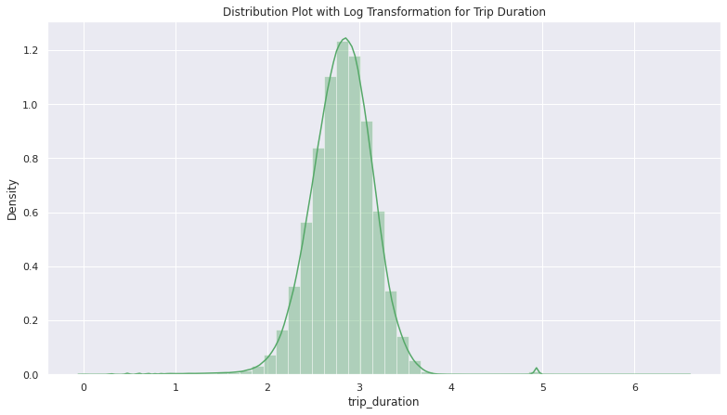
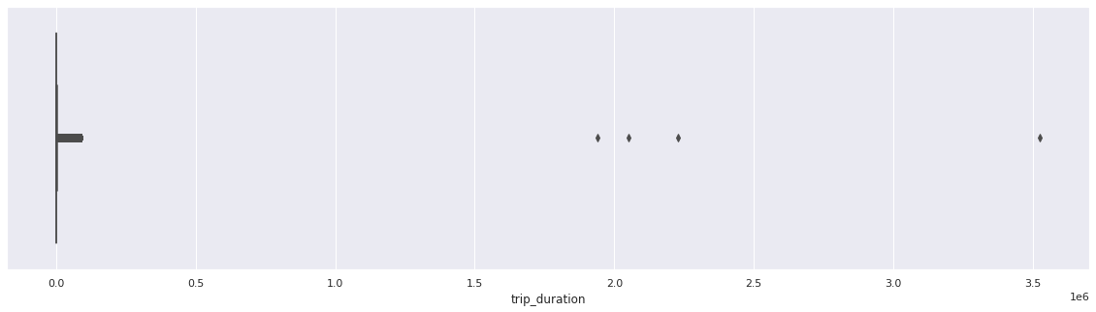
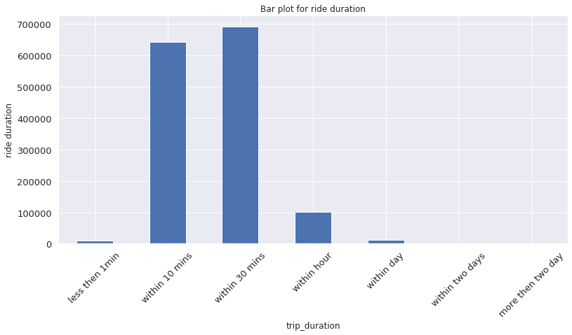
Univariate- Distribution Plot with Log Transformation for Trip Duration, Boxplot, Bar plot for ride duration
From boxplot and distplot:- Some rides durations are over 100000 seconds which are clearly outliers and should be removed. There are some rides which took 1 sec duration to complete which is 0 km/hr. Major trip durations took between 10-20 mins to complete.
There are some rides with more than 24 hours of travel duration i.e. 86400 seconds. Which might have occured on weekends for the outstation travels. So we Removing rides over 86400 sec. From bar plot:- Most of the rides completed within 10 to 30 minutes

Slide 9
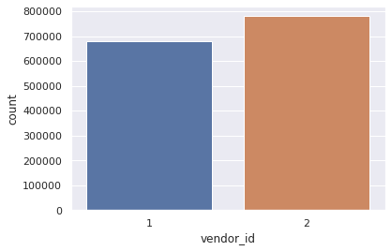
Univariate – Vendor Market
From countplot we can see that both vendors have good and nearly same market but vendor 2 have more market compare to 1

Slide 10
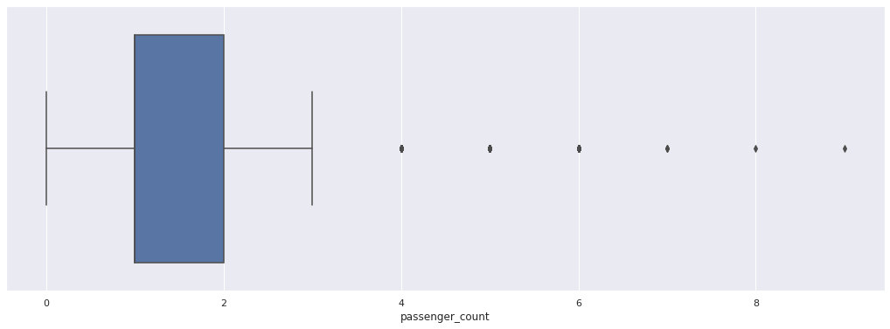
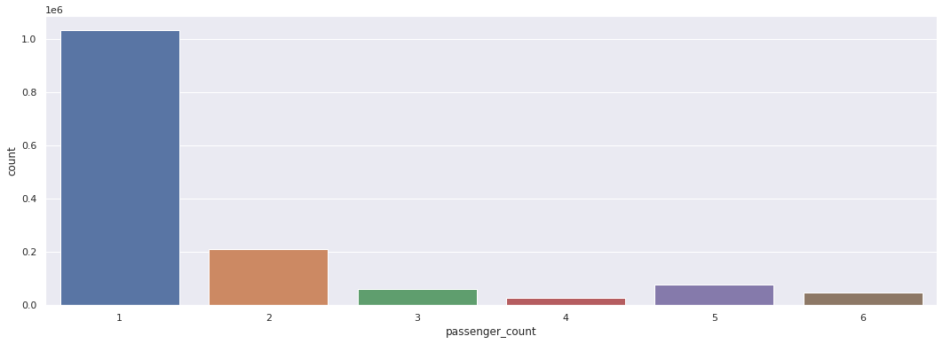
Univariate – how many passenger ride in their single ride.
From boxplot and value counts method we find that:- There are 60 rides with 0 passenger but passenger count is driver entered value and it is common sense passenger without rides not possible so during this rides i think driver forget to enter passenger count so we replace this 0 passenger with 1. There are only 3 rides with 7 passenger, 1 rides with 9 passenger, 1 rides with 8 passenger so this is outlier. So we want to remove this outlier because its affect our further analysis. Most of the rides done with 1 & 2 passenger.
Remove the outlier where passenger count greater than 6 removed. Replace 0 passenger with 1. From countplot:- Most of the rides are done with 1 passenger Less number of rides done with 3,4,5,6 number of passenger Most of the rides done with 2 passenger after single passenger.

Slide 11
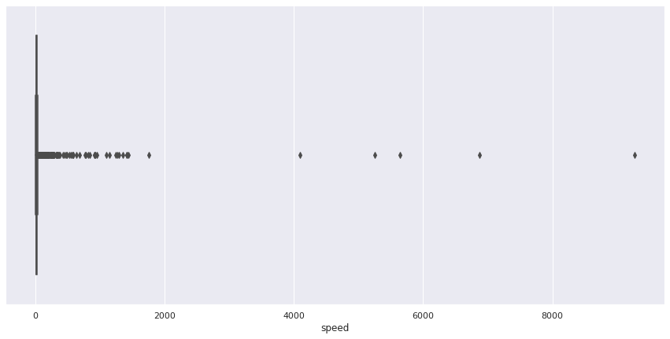
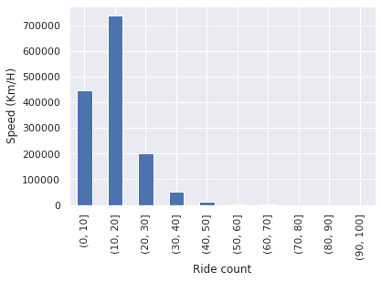
Univariate – speed with different rides.
From boxplot:- Many rides of the speed of taxi over 200 km/hr which clearly shows that outlier. so we want to remove that over speed and analyse the speed upto 104 km/hr as per speed limit.
From bar plot:- Most of the rides speed have 10 to 20 km/hr Some rides speed between upto 10 km/hr CodeText

Slide 12
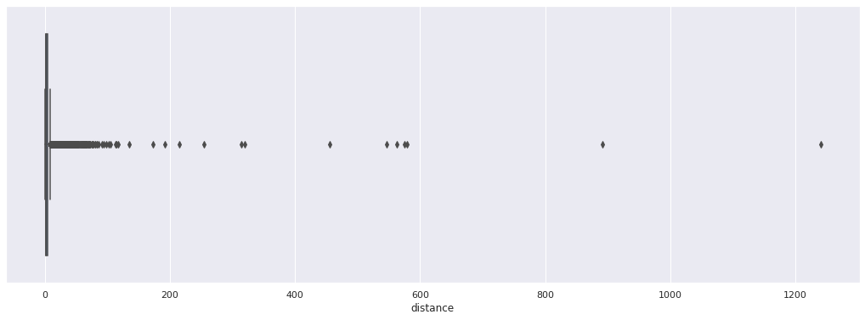
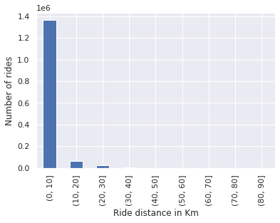
Univariate – distance takes by different rides
From box plot:- There are some rides which is over 100 miles i.e. 160.93 km There are some rides which is 0 miles i.e. 0 km. There are 5897 rides which is 0 miles i.e. 0 km.
From bar plot:- Mostly the ride taken between 1 to 10 km. Most of the ride taken between 0 to 30 km.

Slide 13
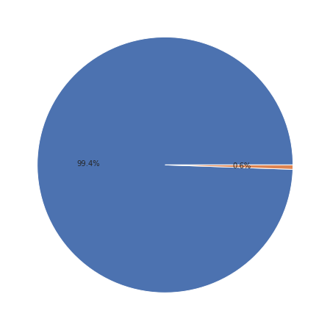
Univariate – Ride Record
from pie chart:- shows that only about 0.6% of the ride details were stored in the vehicle first before sending it to the server. shows that 99.4% of the ride details were not stored in the vehicle first before sending it to the server. Its shows that only 8045 ride details were stored in the vehicle first before sending it to the server. shows that 1450599 of the ride details were not stored in the vehicle first before sending it to the server.

Slide 14
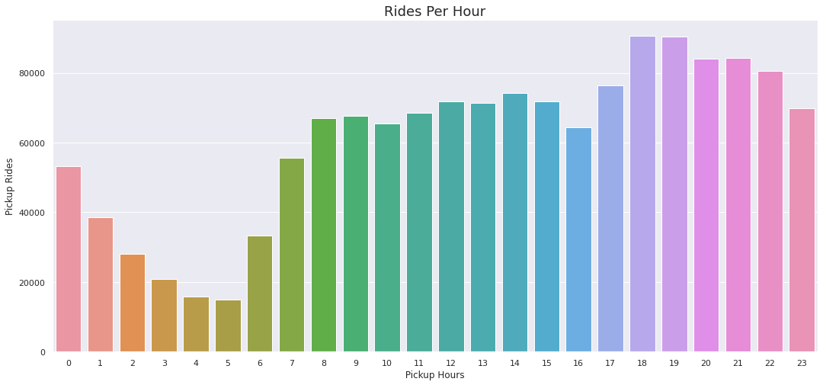
Univariate – Rides Per Hour
From countplot:- It's inline with the general trend of taxi pickups which starts increasing from 6AM in the morning and then declines from late evening i.e. around 8 PM. There is no unusual behavior here.

Slide 15
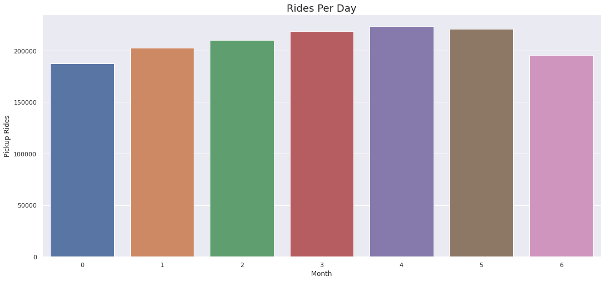
Univariate – Rides Per Day
From countplot:- Here we can see an gradually increasing trend of taxi pickups starting from Monday till Friday. The trend starts declining from saturday till monday which is normal where some office going people likes to stay at home for rest on the weekends.

Slide 16
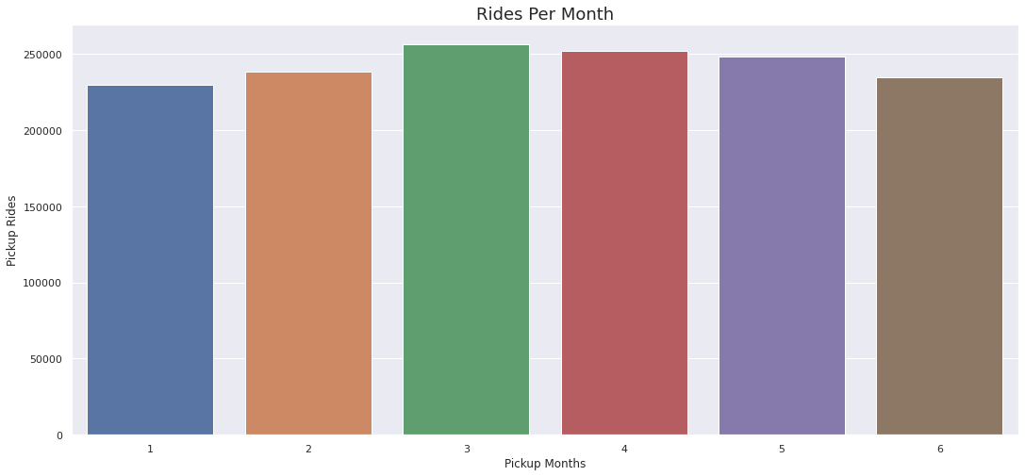
Univariate – Rides Per Month
From countplot:- Quite a balance across the months here. It could have been more equivalent if we wouldn't have removed the inconsistent records in our study of the univariate analysis.

Slide 17
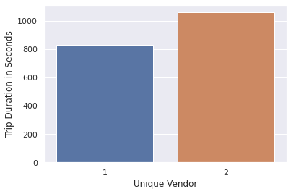
Bivariate – Vendor Trip Duration in Seconds
From barplot:- Vendor id 2 taken more rides duration as compare to 1. Vendor id 1 averagely ride duration approx 200 seconds higher than 1.

Slide 18
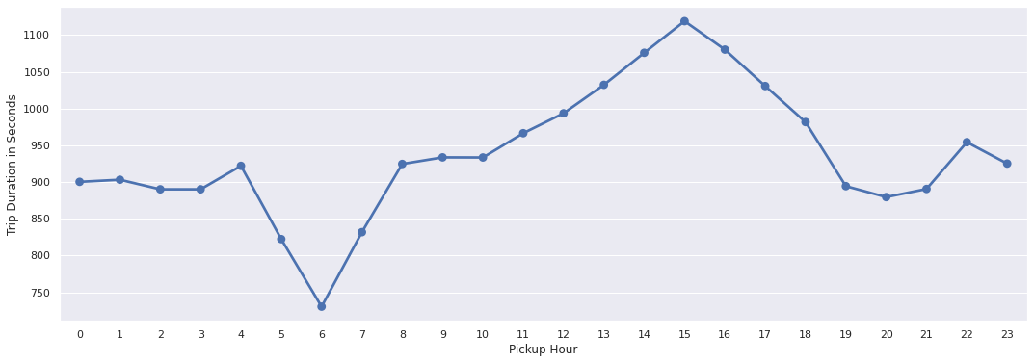
Bivariate – Pickup Hour Trip Duration in Seconds
From point plot:- Average rides duration less at 6 AM when their minimum trafic on roads. Average rides duration high at 3 PM when their maximum trafic on roads. Ride duration on an average is similar during early morning hours i.e. before 6 AM & late evening hours i.e. after 6 PM.

Slide 19
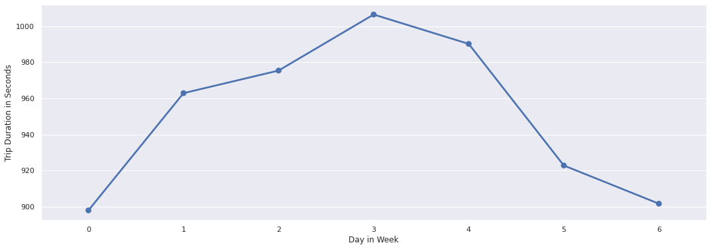
Bivariate – Day in Week Trip Duration in Seconds
From point plot:- We can see that ride duration is almost equally distributed across the week on a scale of 0-1000 minutes with minimal difference in the duration times. Also, it is observed that trip duration on thursday is longest among all days.

Slide 20
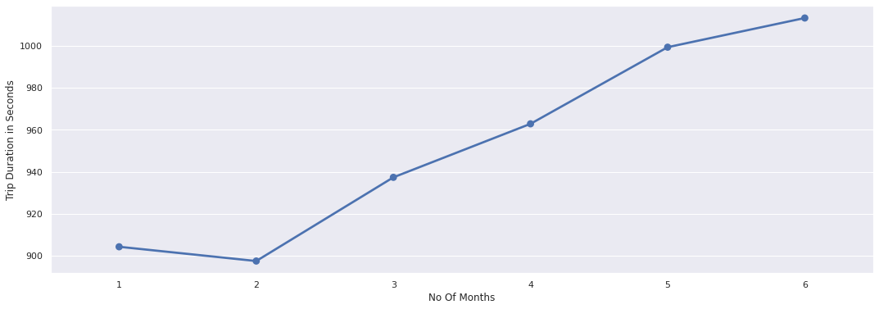
Bivariate – No Of Months Trip Duration in Seconds
From point plot:- We can see an increasing trend in the average ride duration along with each subsequent month. The duration difference between each month is not much. It has increased gradually over a period of 6 months. It is lowest during february when winters starts declining. There might be some seasonal parameters like wind/rain which can be a factor of this gradual increase in trip duration over a period. Like May is generally the considered as the wettest month in NYC and which is inline with our visualization. As it generally takes longer on the roads due to traffic jams during rainy season. So natually the trip duration would increase towards April, May and June.

Slide 21
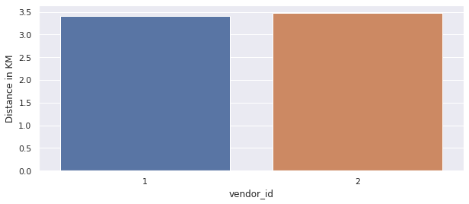
Bivariate – Vendor Distance in KM
From bar plot:- Both vendor 1 & 2 trip distance nearly same

Slide 22
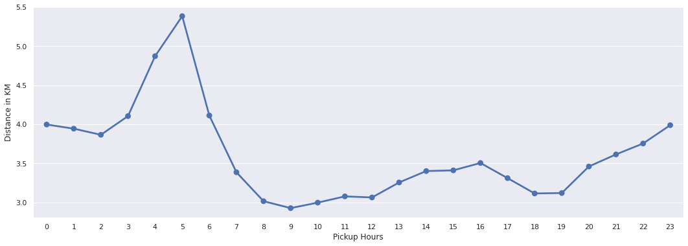
Bivariate – distance with different hours in day
From point plot:- trips distance is higher in early morning because: Outstation trips taken during the weekends. Longer trips towards the city airport which is located in the outskirts of the city. After early morning distance decreases upto 8 AM and after 8 AM distance nearly equal upto 7 PM in evening which is range between 3 to 3.5 KM. It starts increasing gradually towards the late night hours starting from evening till 5 AM and decrease steeply towards morning.

Slide 23
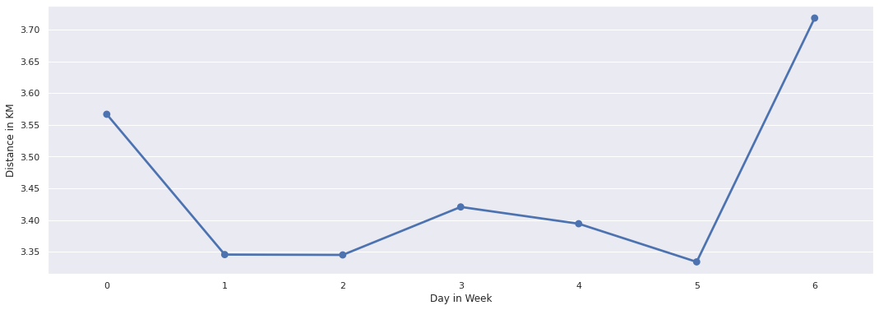
Bivariate – Trip distance covered on each day of the week.
From point plot:- So it's a fairly equal distribution with average distance metric verying around 3.5 km/h with Sunday being at the top may be due to outstation trips or night trips towards the airport.

Slide 24
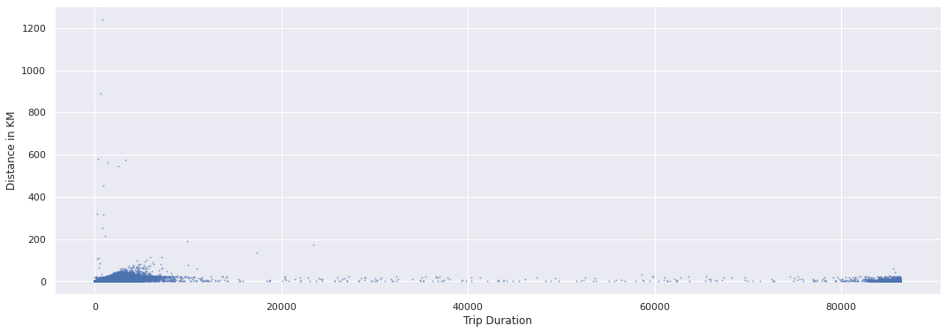
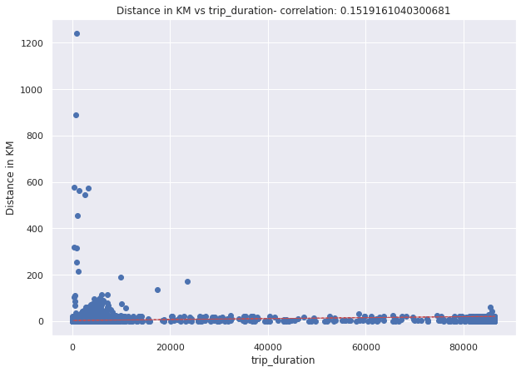
Bivariate – Trip Duration Distance in KM
From plots:- There are very strong relationship between distance and trip duration There were few trips which covered huge distance of approx 200 kms within very less time frame, which is unlikely and should be treated as outliers. There are lots of trips which covered negligible distance but clocked more than 20,000 seconds in terms of the Duration.

Slide 25
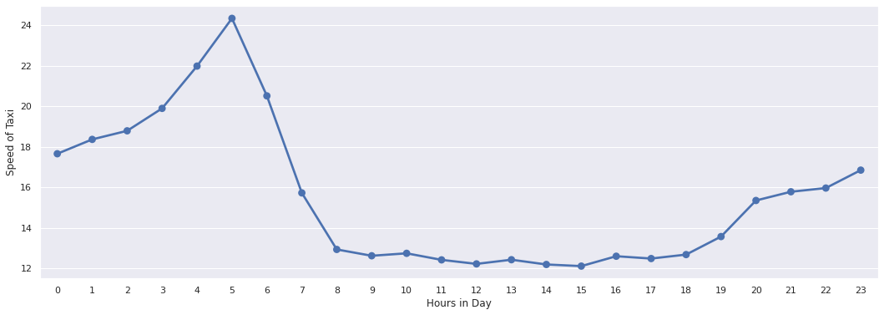
Bivariate – Distribution of speed per hour
From point plot:- Average speed tend to increase after late evening and continues to increase gradually till the late early morning hours. Average taxi speed is highest at 5 AM in the morning, then it declines steeply as the office hours approaches. Average taxi speed is more or less same during the office hours i.e. from 8 AM till 6PM in the evening.

Slide 26
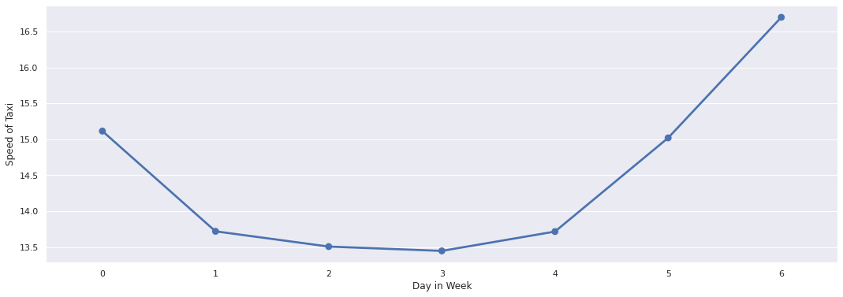
Bivariate – Distribution of speed per Weekday
From point plot:- Average taxi speed is higher on weekend as compared to the weekdays which is obvious when there is mostly rush of office goers and business owners. Even on monday the average taxi speed is shown higher which is quite surprising when it is one of the most busiest day after the weekend.

Slide 27
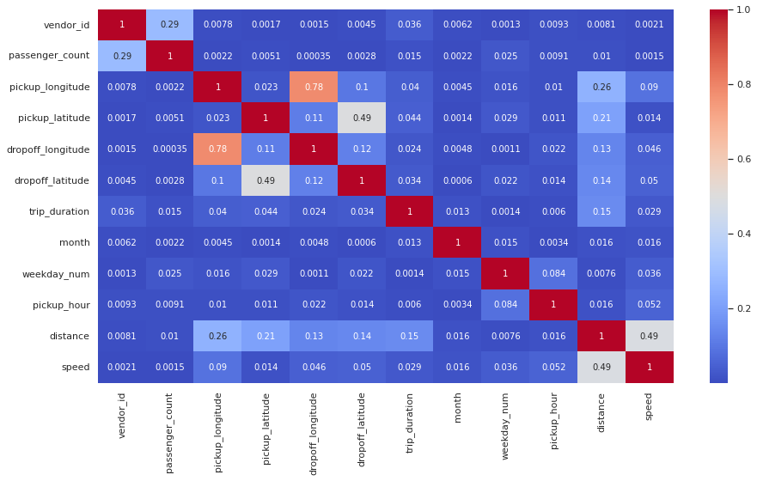
Multivariate – Correlation Heatmap
From Heatmap:- There are some maximum multicolinearity between pickhup longitude and dropoff longitude which is = 0.78 pickhup latitude and dropoff latitude which is = 0.49 distance and speed which is = 0.49 Some combinations of features shows slight correlation

Slide 28
Hypothesis Testing
Hypothesis testing = Weekends has more traffic as compared to week days.
Null Hypothesis : H0 : mean of count of trips on weekday <= mean of mean of count of trips on weekend day
Alternate Hypothesis : H1 : mean of count of trips on weekday > mean of mean of count of trips on weekend day
Performing statistical test we find that P-Value: 0.5274204439460304, Hence we are failed to reject null hypothesis (H0) for significane level 0.05. So Number of trips on weekends are comparatively more than number of trips on weekdays.

Slide 29
Feature Engineering & Data Pre-processing
Feature engineering is the pre-processing step of machine learning, which is used to transform raw data into features that can be used for creating a predictive model using Machine learning or statistical Modelling. Feature engineering in machine learning aims to improve the performance of models.
Feature selection:-
Feature Selection on the other hand is a machine learning technique applied on these (numerical) features.
we select a subset of the original feature set based on the statistical significance of different parameters.
1. Creating dummy variable :- firstly we do the Dummify all the categorical features like "store_and_fwd_flag, vendor_id, month, weekday_num, pickup_hour, passenger_count" except the label i.e. "trip_duration“
2. Let's assign the values to X & Y array from the dataset.
3. We will use backward elimination technique to select the best features to train our model.
we finally reached the combination of optimum features with each feature having p value < 0.05.

Slide 30
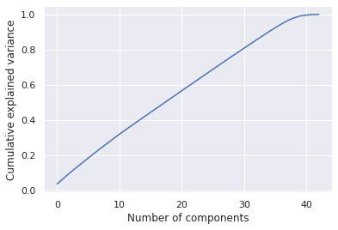
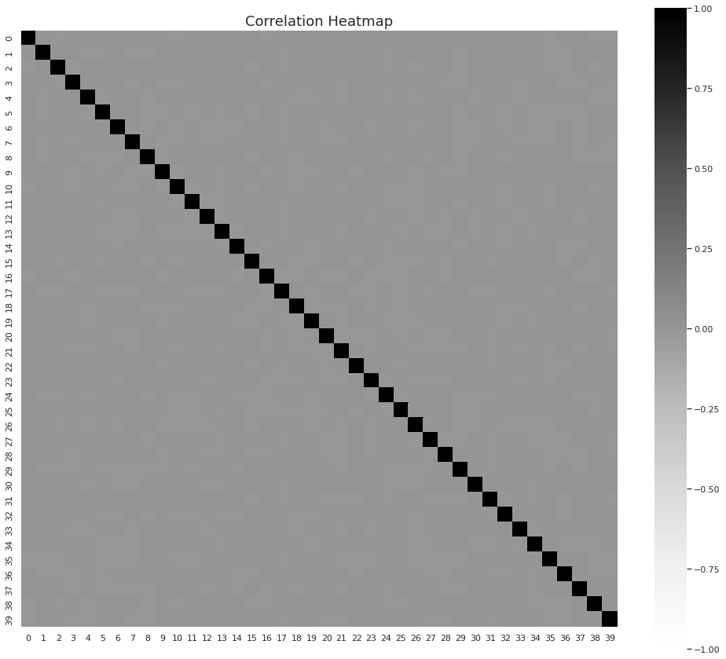
Feature extraction:-
Feature Extraction transforms an arbitrary data, such as text or images, into numerical features that is understood by machine learning algorithms.
We will use PCA for feature extraction i.e. Principal Component Analysis. It is a statistical procedure that uses an orthogonal transformation to convert a set of observations of possibly correlated variables into a set of values of linearly uncorrelated variables called principal components.
1. Split Data
2. Scale Data:- So here we scale the input varibles first before applying PCA to standardise the variance and avoid the bias. Lets Scale the data using StandardScaler.
3. PCA Application:- From plot we can see that almost 40 variables
are needed for capturing atleast 99% of the variance in the
training dataset. Hence we will use the same set of variables.
4. Correlation of Feature extraction
From above heatmap:-
All of the features shows NO correlation at all.
Because feature extraction removes all
collinearity.

Slide 31
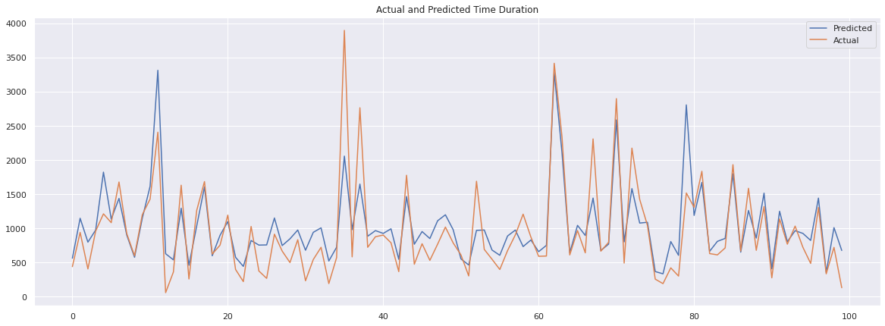
ML Model Implementation - Multiple Linear Regression
Multiple Linear Regression:-It took very less time to train the model on dataset of more than 1 million records. so its clearly that linear regression is extremly fast to train on the high dimension datasets consisting of even millions of records.but its have Very poor Root mean squared value and adjusted R-squre value which shows that bad in prediction.Both the models i.e. from the feature selection and the feature extraction group resulted quite bad in prediction.

Slide 32
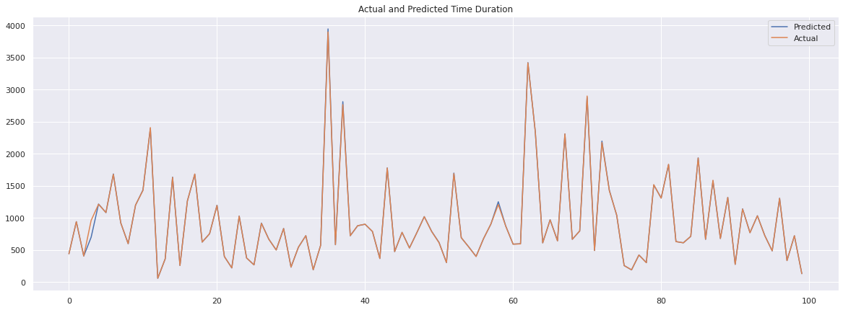
ML Model Implementation - Decision Tree Regressor
Decision Tree:- It took less time to train the model on dataset.It has very good Root mean squared value and adjusted R-squre value in raw and feature selection data which shows that model is good in prediction but its very bad in feature extraction data.

Slide 33
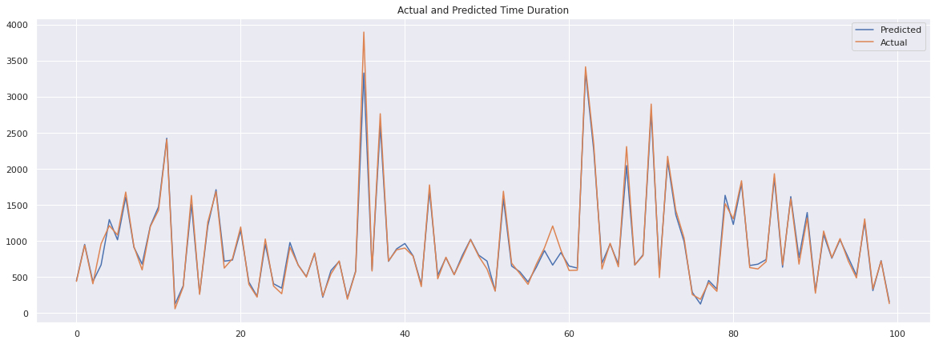
ML Model Implementation - XGBoost Regressor
XGBoost Regressor:- Comparatively XGBoost takes more time to train the model on dataset. But its most accurate among all algorithm that we use here. its also have very good Root mean squared value and adjusted R-squre value in raw and feature selection data which shows that model is good in prediction but its very bad in feature extraction data.also there is very small improvement in RMSE and adjusted r-squre value using hyperparameter tuning.Also, the RMSE score on the raw data and feature selected data are same, which disproves the theory that it is always better to select the relevant features which are statistically important. As the data behaves differently in different models.

Slide 34
ML Model Implementation - Random Forest Regressor
Random Forest Regressor:- Its takes maximum time to compute among other algorithm that we use. compare to linear regressor there are good Root mean squared value and adjusted R-squre value in raw and feature selection data which shows that model is good in prediction but its very bad in feature extraction data.RMSE score and adjusted r-squre for the feature selection group is more or less same as the raw data score.

Slide 35
Challenges Faced
Data quality: The accuracy of the prediction model heavily depends on the quality of the data used. Factors such as missing or incorrect data, outliers, and inconsistencies can affect the model's accuracy. Ensuring data quality is an important challenge to overcome.
Data size: NYC is a busy city with millions of taxi trips happening every day. This huge volume of data can create issues in terms of processing, storage, and analysis. Handling such a large dataset can be a challenge.
Feature selection: The selection of the right set of features is crucial in building an accurate prediction model. However, with so many variables to consider, choosing the most relevant ones can be a daunting task.
Model selection: There are various machine learning algorithms available to use for this type of project, such as decision trees, random forests, neural networks, etc. Choosing the right model and tuning its hyperparameters can be a challenge.
Time and resource constraints: With a limited amount of time and resources, it can be challenging to build a model that is both accurate and efficient. Balancing the accuracy of the model with the time and resources available is a key challenge.
Real-time prediction: Real-time prediction of taxi trip time requires a model that can process new data and make predictions quickly. Developing a model that can make accurate real-time predictions can be a challenge.

Slide 36
Conclusion
Multiple Linear Regression:-It took very less time to train the model on dataset of more than 1 million records. so its clearly that linear regression is extremly fast to train on the high dimension datasets consisting of even millions of records.but its have Very poor Root mean squared value and adjusted R-squre value which shows that bad in prediction.Both the models i.e. from the feature selection and the feature extraction group resulted quite bad in prediction.
Decision Tree:- It took less time to train the model on dataset.It has very good Root mean squared value and adjusted R-squre value in raw and feature selection data which shows that model is good in prediction but its very bad in feature extraction data.
XGBoost Regressor:- Comparatively XGBoost takes more time to train the model on dataset. its also have very good Root mean squared value and adjusted R-squre value in raw and feature selection data which shows that model is good in prediction but its very bad in feature extraction data.also there is very small improvement in RMSE and adjusted r-squre value using hyperparameter tuning.Also, the RMSE score on the raw data and feature selected data are same, which disproves the theory that it is always better to select the relevant features which are statistically important. As the data behaves differently in different models.
Random Forest Regressor:- Its takes maximum time to compute among other algorithm that we use. compare to linear regressor there are good Root mean squared value and adjusted R-squre value in raw and feature selection data which shows that model is good in prediction but its very bad in feature extraction data.RMSE score and adjusted r-squre for the feature selection group is more or less same as the raw data score.
Feature extraction didn't helped in anyway to improve the RMSE score with any of the regressor models. This shows us that the feature extraction is somewhat not a good technique to preprocess the data before feeding it into the regressor models for the continous target value prediction. Whereas it also depends on the type and features of data that how it behaves with the model.

Slide 37
Thank You

